Slide 1
Social Media Report test
for
DOTCOMMA STUDIO OWNS ALL CONTENTS ON THIS DOCUMENT, YOU CAN NOT REPRODUCE, COPIED OR STORE IT FOR ANY MEANS WITHOUT PERMISSION FROM DOTCOMMA STUDIO COPYRIGHT ©2022

Slide 2
Overall Insight
Insight | Instagram
Followers
Reach
Profile Visits
Engagement/Interactions
Untuk insight bulan Desember, seluruh insight Instagram lorem mengalami kenaikan yang cukup signifikan kecuali pada bagian followers.

Slide 3
Top Performing Posts
in month

Slide 4
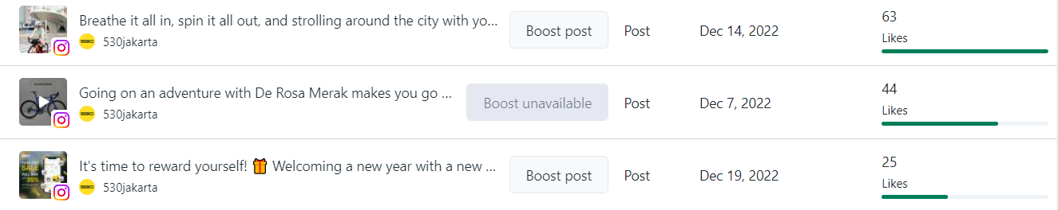
TOP 3 POST BASED ON LIKES

Slide 5
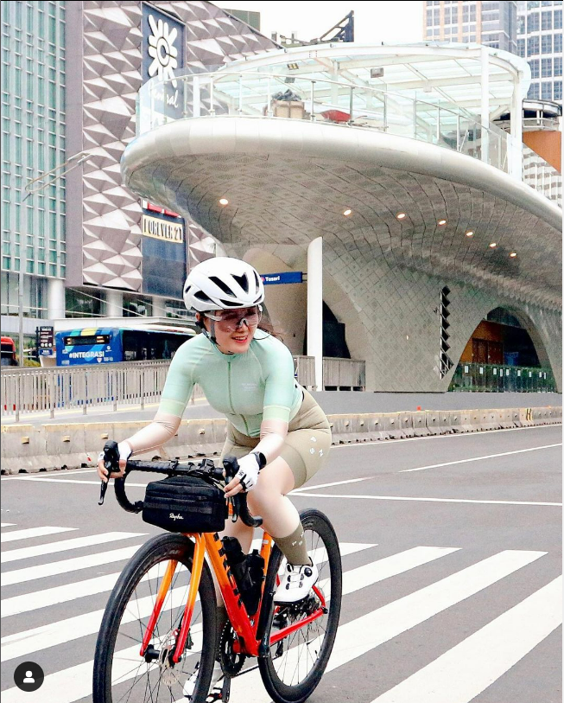
TOP 3 ORGANIC POST BASED ON LIKES
TOP 3 ORGANIC POST BASED ON LIKES
lorem
lorem

Slide 6
TOP 3 ORGANIC POST BASED ON LIKES
TOP 3 ORGANIC POST BASED ON LIKES
lorem
lorem

Slide 7
TOP 3 ORGANIC POST BASED ON LIKES
TOP 3 ORGANIC POST BASED ON LIKES
lorem
lorem

Slide 8
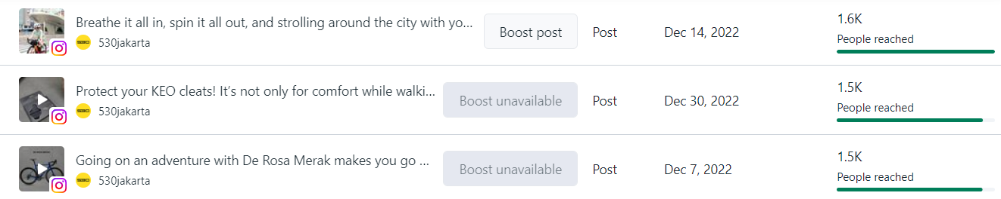
TOP 3 POST BASED ON REACH

Slide 9
TOP 3 LIKES ORGANIC POST
TOP 3 ORGANIC POST BASED ON REACH
Breathe it all in, spin it all out, and strolling around the city with your bike buddy 🚴‍♀️
📸: @_dyhael_
#530jakarta #pesepeda #pesepedaindonesia #pesepedacantik #cyclinglife
Post ini diupload pada Rabu, 14 Desember 2022 dan mendapat 1.6k likes.

Slide 10
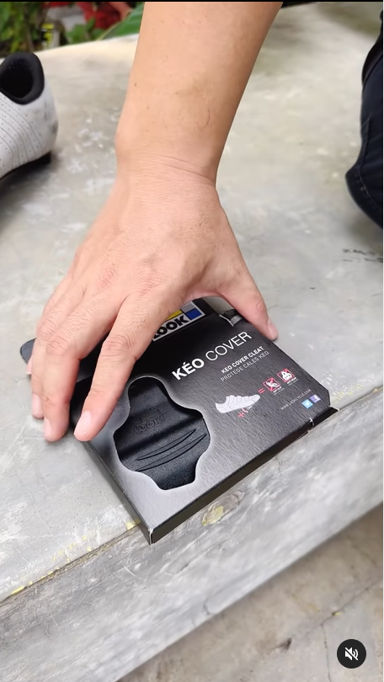
TOP 3 LIKES ORGANIC POST
TOP 3 ORGANIC POST BASED ON REACH
Protect your KEO cleats!
It’s not only for comfort while walking around with your cycling shoes, wearing KEO Cover also lengthen the life of your cleats and improve safety thanks to its anti-slip surface.
#530jakarta #cyclingapparel #tokosepeda #perlengkapansepeda #aksesorissepeda #keo #lookcycle #cleats #reels #reelsvideo #reelsinstagram
Post ini diupload pada Jumat, 30 Desember 2022 dan mendapat 1.5K reach.

Slide 11
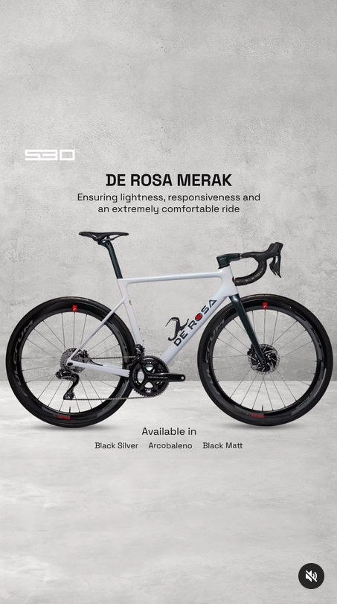
TOP 3 LIKES ORGANIC POST
TOP 3 ORGANIC POST BASED ON LIKES
Going on an adventure with De Rosa Merak makes you go up and downhill effortlessly, especially when you are in a race!
Can’t wait to have it right?
#530jakarta #cyclingadventures #cyclingdownhill #bersepeda #bersepedaindonesia
Post ini diupload pada Rabu, 7 Desember 2022 dan mendapat 1.5k reach.

Slide 12
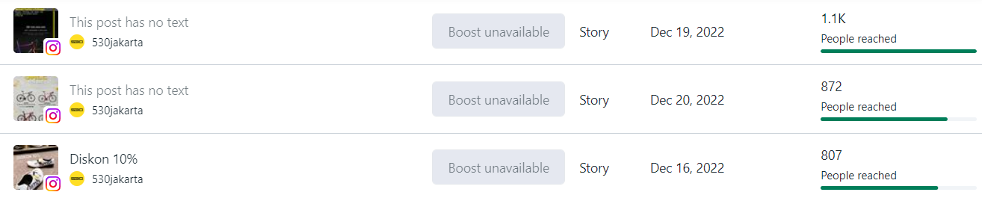
TOP 3 STORY BASED ON REACH

Slide 13
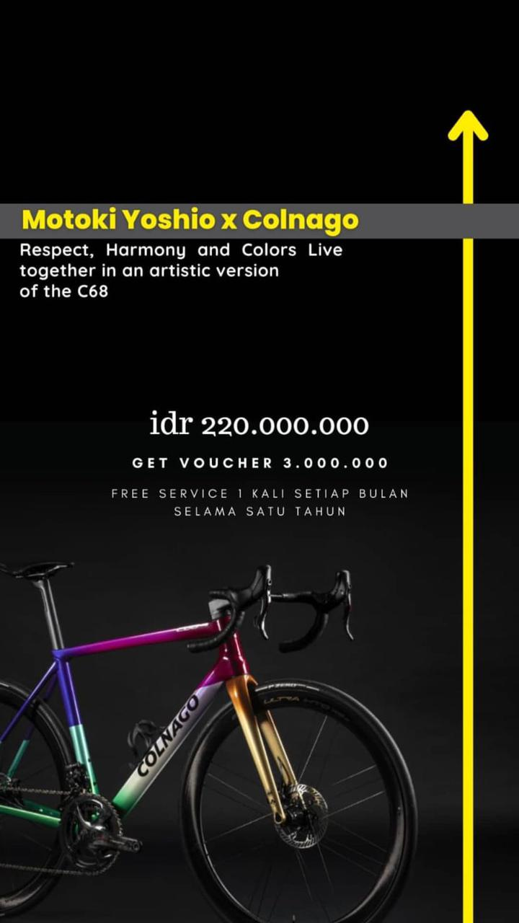
TOP 3 STORY BASED ON REACH
Story ini diupload pada Senin, 19 Desember 2022 dan mendapat reach sebanyak 1.1k.

Slide 14
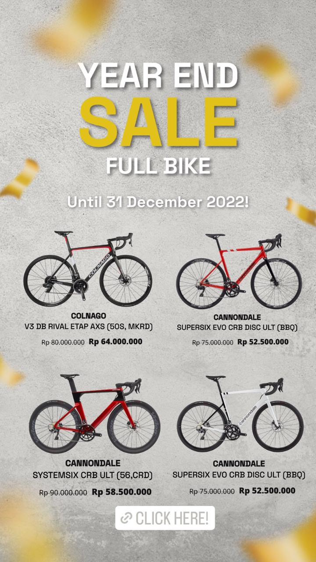
TOP 3 ORGANIC STORY BASED ON REACH
Story ini diupload pada Selasa,20 Desember 2022 dan mendapat reach sebanyak 872.

Slide 15
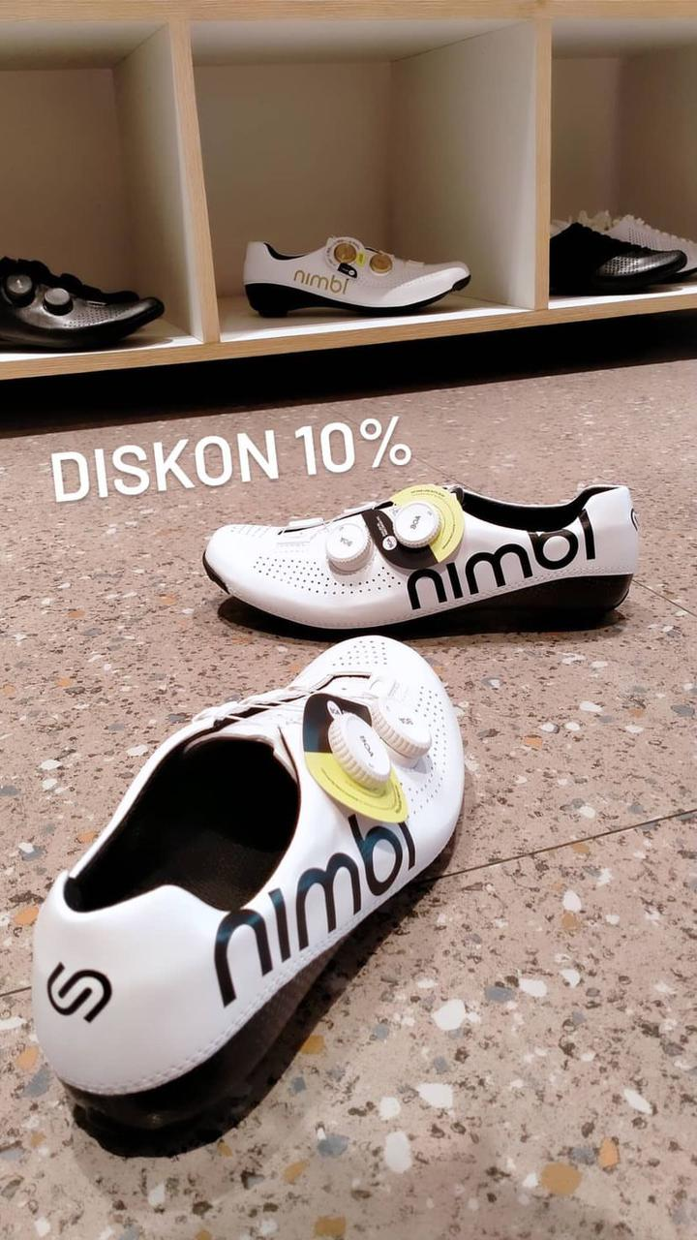
TOP 3 ORGANIC STORY BASED ON REACH
Story ini diupload pada Jumat, 16 Desember 2022 dan mendapat reach sebanyak 807.

Slide 16
Least Performing Posts
in December

Slide 17
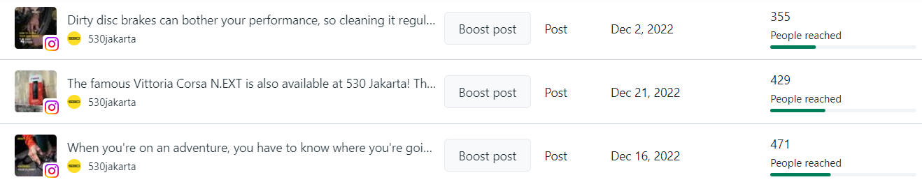
3 LEAST PERFORMING POSTS BASED ON REACH

Slide 18
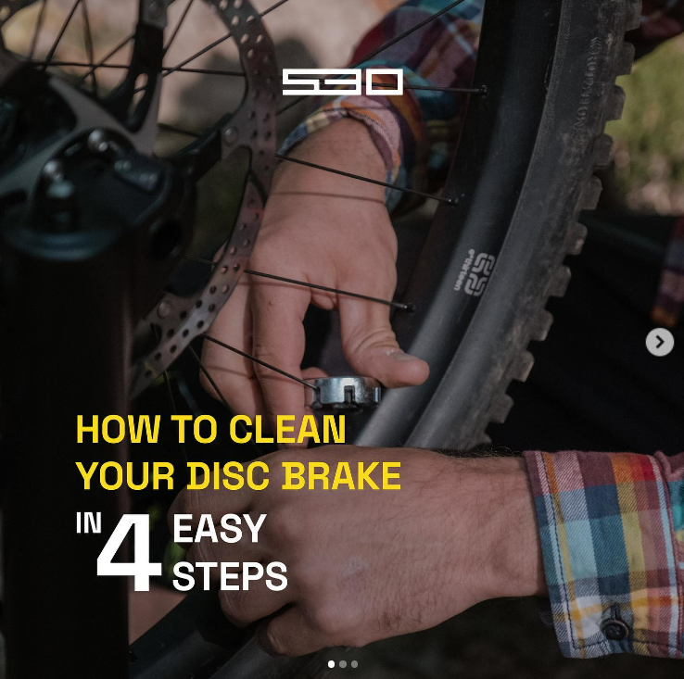
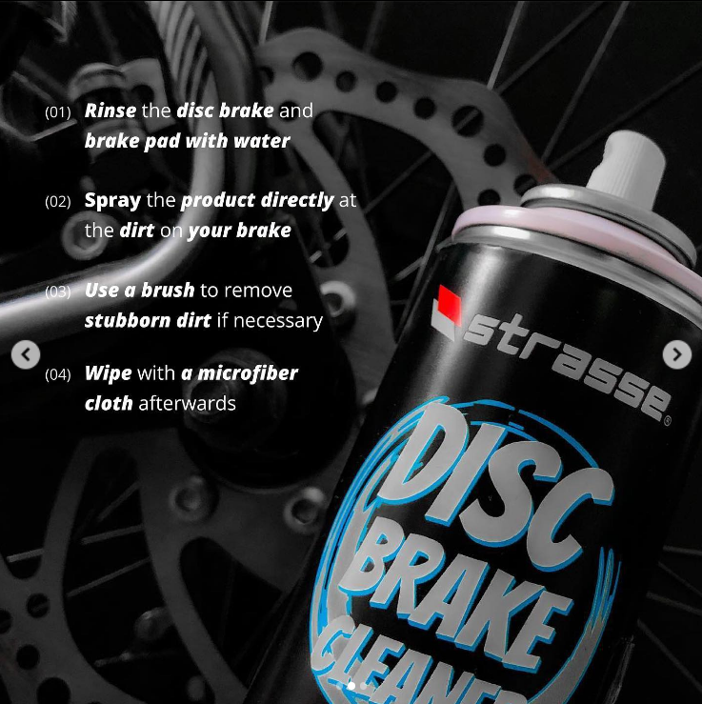
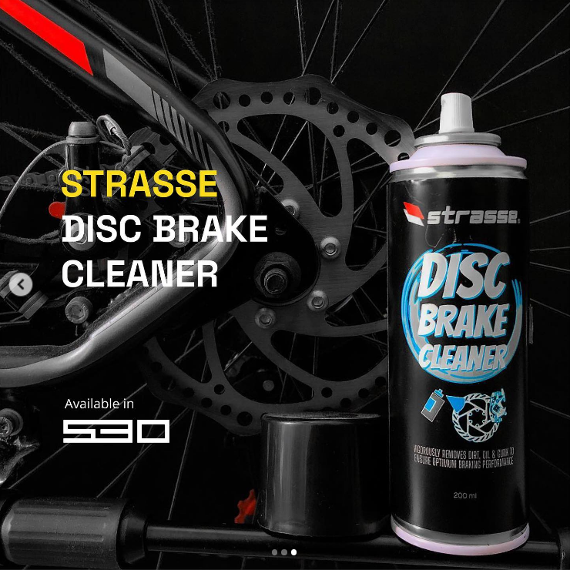
LEAST PERFORMING POSTS
3 LEAST PERFORMING POST BASED ON REACH
Dirty disc brakes can bother your performance, so cleaning it regularly is highly recommended! 530jakarta have 4 easy steps for cleaning it.
Find out more in this post!
#530jakarta #diskbrakes #remcakram #mybicycle #yourbicycle
Post ini diupload pada Jumat, 2 Desember 2022 dan mendapat reach sebanyak 355.

Slide 19
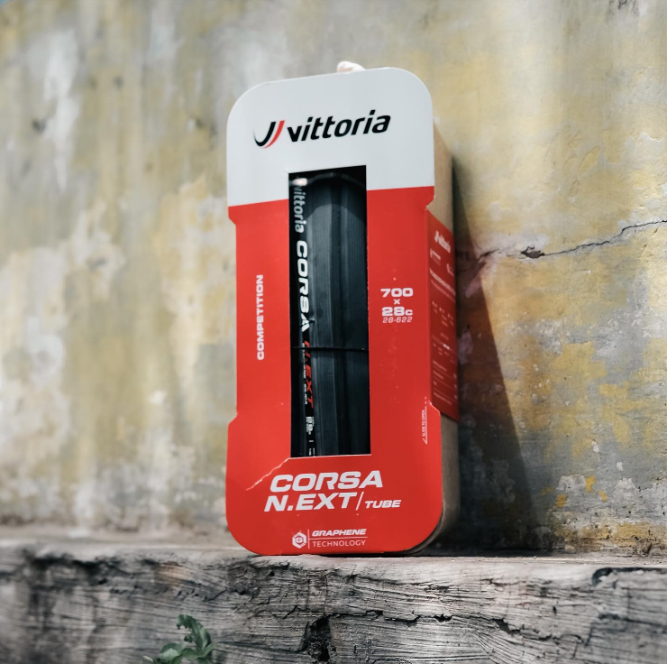
LEAST PERFORMING POSTS
3 LEAST PERFORMING POST BASED ON REACH
The famous Vittoria Corsa N.EXT is also available at 530 Jakarta!
This superior road tire is guaranteed to bring you to the finish line much faster than everyone else with excellent rolling efficiency and grip. Try it for yourself 😜
#530jakarta #vittoria #tires #bansepeda #vittoriatires #tokosepeda #tokosepedajakarta #perlengkapansepeda
Post ini diupload pada Rabu, 21 Desember 2022 dan mendapat reach sebanyak 429.

Slide 20
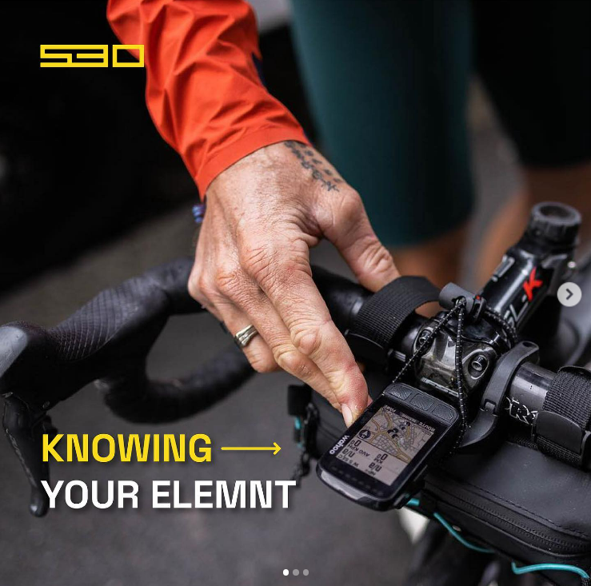
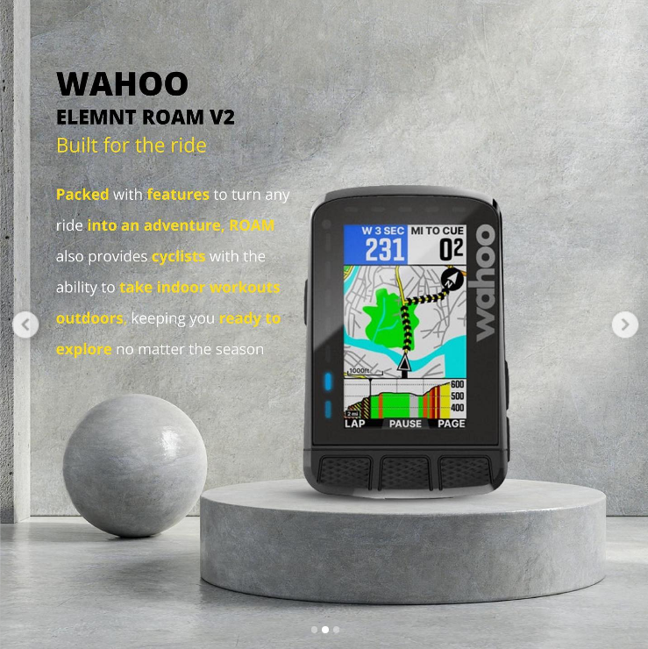
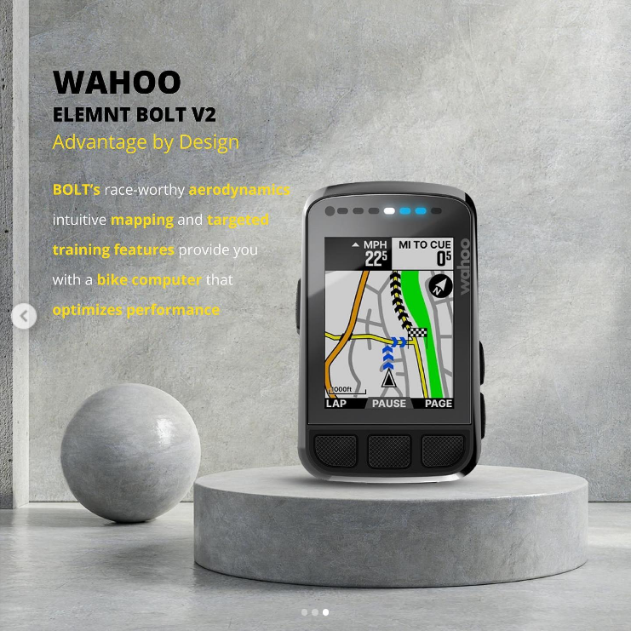
LEAST PERFORMING POSTS
3 LEAST PERFORMING POST BASED ON REACH
When you're on an adventure, you have to know where you're going. These GPS from Wahoo can help you 🧭 But before you buy it, you have to know which GPS suits your wants and needs.
Is it Elemnt Roam V2 or Elemnt Bolt V2?
#530jakarta #sepeda #sepedaindonesia #sepedaan #sepedatouring
Post ini diupload pada Jumat, 19 Desember 2022 dan mendapat reach sebanyak 471.

Slide 21
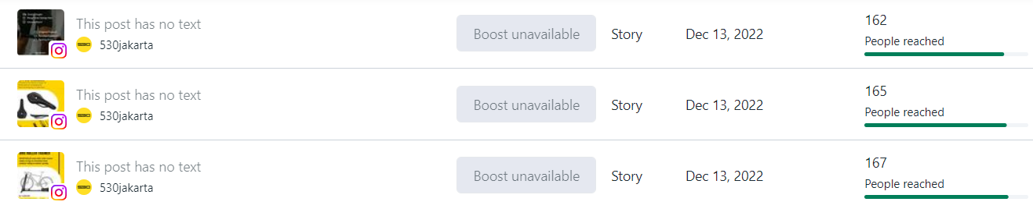
3 LEAST PERFORMING STORY BASED ON REACH

Slide 22
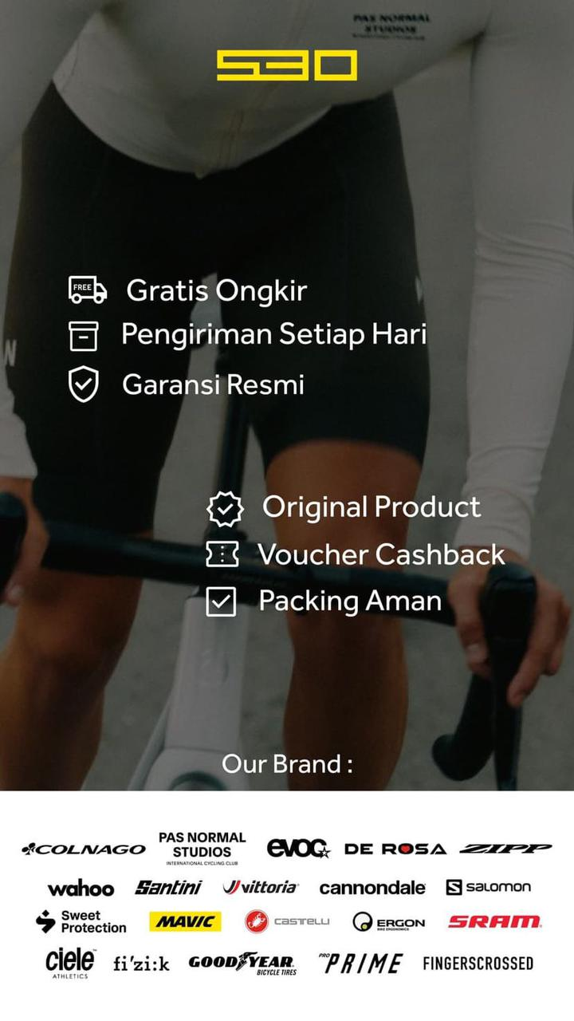
3 LEAST PERFORMING STORY
3 LEAST PERFORMING STORY BASED ON REACH
Story ini diupload pada Selasa, 13 Desember 2022 dan mendapat reach sebanyak 162.

Slide 23

3 LEAST PERFORMING STORY
3 LEAST PERFORMING STORY BASED ON REACH
Story ini diupload pada JSelasa, 13 Desember 2022 dan mendapat reach sebanyak 165.

Slide 24

3 LEAST PERFORMING STORY
3 LEAST PERFORMING STORY BASED ON REACH
Story ini diupload pada Selasa, 13 Desember 2022 dan mendapat reach sebanyak 167.

Slide 25
NOTES:
Berdasarkan top likes dan reach, audience lebih menyukai konten repost riders lokal, reels produk, dan carousel promo
Konten yang paling banyak mendapat likes berbentuk UGC dan reels
Untuk story, audience kurang berminat pada story berbentuk promo yang diupload secara bersamaan. Kedepannya dapat ditambahkan link e-commerce di story promo

